Slide 1
Chapter 4:
Intellectual Property

Slide 2
Copyright
Provides owner of an original work five rights
  Reproduction
  Distribution
  Public display
  Public performance
  Production of derivative works
Copyright-related industries represent 6% of U.S. gross domestic product (> $900 billion/yr)
Copyright protection has expanded greatly since 1790
1-<number>

Slide 3
By permission of John Deering and Creators Syndicate, Inc.
1-<number>

Slide 4
Key Court Cases and Legislation
Gershwin Publishing v. Columbia Artists
Basic Books v. Kinko’s Graphics
Davey Jones Locker
No Electronic Theft Act
1-<number>

Slide 5
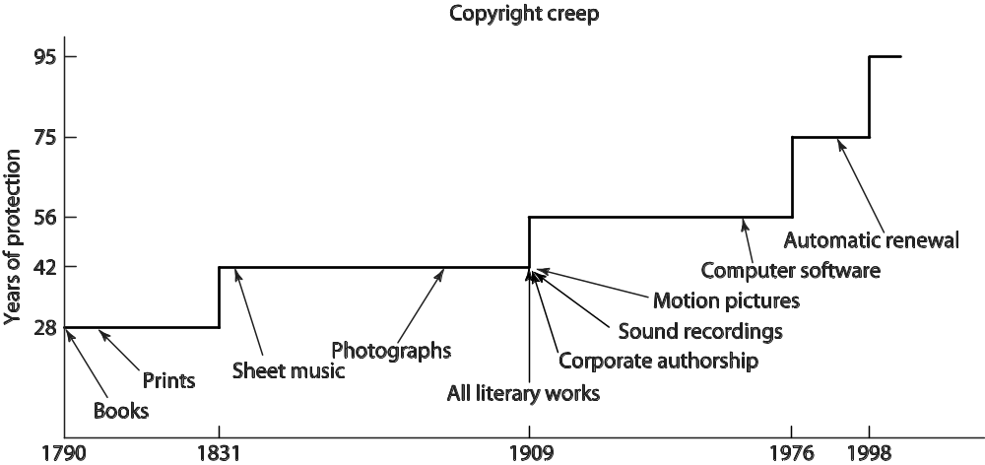
Copyright Creep
1-<number>

Slide 6
Copyright Creep
Since 1790, protection for books extended from 28 years to 95 years or more
Some say latest extension done to prevent Disney characters from becoming public domain
Group of petitioners challenged the Copyright Term Extension Act of 1998, arguing Congress exceeded Constitutional power
U.S. Supreme Court ruling
  CTEA does not create perpetual copyrights
  CTEA is constitutional
1-<number>

Slide 7
4.4 Fair Use
1-<number>

Slide 8
Fair Use Concept
Sometimes legal to reproduce a copyrighted work without permission
Courts consider four factors
  Purpose and character of use
  Nature of work
  Amount of work being copied
  Affect on market for work
1-<number>

Slide 9
Sony v. Universal City Studios
Sony introduced Betamax VCR (1975)
People started time shifting TV shows
Movie studios sued Sony for copyright infringements
U.S. Supreme Court ruled (5-4) that time shifting is fair use
1-<number>

Slide 10
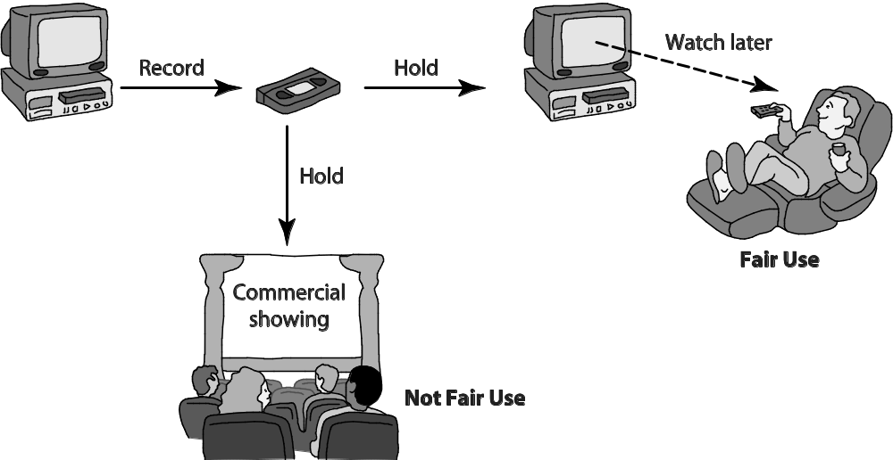
Time Shifting
1-<number>

Slide 11
Digital Recording Technology
Copying from vinyl records to cassette tapes introduced hiss and distortions
Introduction of compact disc a boon for music industry
  Cheaper to produce than vinyl records
  Higher quality
  Higher price ⇒ higher profits
BUT it’s possible to make a perfect copy of a CD
1-<number>

Slide 12
Audio Home Recording Act of 1992
Protects rights of consumers to make copies of analog or digital recordings for personal, noncommercial use
  Backup copy
  Give to family member
Digital audio recorders must incorporate Serial Copyright Management System (SCMS), so consumers can’t make a copy of a copy
1-<number>

Slide 13
RIAA v. Diamond Multimedia
MP3 compression allowed songs to be stored in 10% of the space, with little degradation
Diamond introduced Rio MP3 player (1998)
People started space shifting their music
RIAA started legal action against Diamond for violation of the Audio Home Recording Act
U.S. Court of Appeals, 9th Circuit, affirmed that space shifting is consistent with copyright law
1-<number>

Slide 14
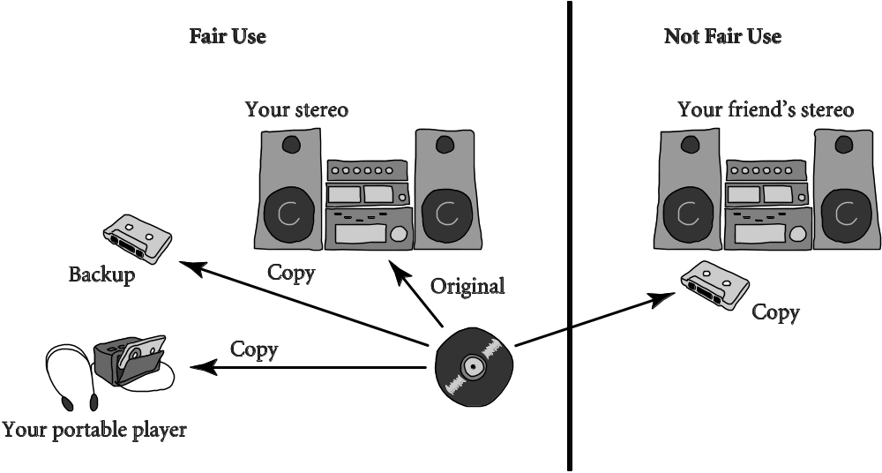
Space Shifting
1-<number>

Slide 15
Kelly v. Arriba Soft
Kelly: Photographer maintained Web site with copyrighted photos
Arriba Soft: Created search engine that returned thumbnail images
Kelly sued Arriba Soft for copyright infringement
U.S. Court of Appeals, 9th Circuit, affirmed that it was fair use
1-<number>

